Slide 1

GAME OF CODES
ABHINANDAN SHARMA(2K19/MC/005)
CHETAN(2K19/MC/034)
BY CODERS, FOR CODERS

Slide 2
OVERVIEW AND MOTIVATION
Codeforces has been a great platform for competitive programming lovers but usually people loose interest in solving those great problems due to fall in their rating, and people get confused what problems to do in this great ocean. We faced the same problem too and thus found a simple yet elegant solution: Making personalized contests and identifying weak, strong topics.
This way students can easily do contests and thus can practice easily. This was the motivation behind this project.

Slide 3
Our TiMeline
August
Ideation Phase
September and October
DESIGN AND FRONT END IMPLEMENTATION
November
BACKEND INTEGRATION AND LOGIN AUTHENTIFICATION

Slide 4
Our FEATURES
Analyzing User’s Performance: We fetch user’s past performance through API’s and then analyze it to predict user’s weak and strong topics and give him problems for the same.
Comparing and viewing Profiles: User can also compare themselves with other coders and can learn from them and see where they lack.
Visualizers: Users can also learn various sorting algorithms and path finding algorithms in a very fun way
One v One Coding Fights: Users can Also do one v one coding fights with friends.

Slide 5
Our FEATURES
Training Zones: Users can also train themselves topic wise or level wise.
Bookmarking: Users can bookmark the questions which seem great to them for future reference.
Targets: Users can track their consistency by setting targets for each day.

Slide 6






TECH STACK WE USED
Here is the whole tech stack we used :
HTML
CSS
JAVASCRIPT
NODEJS
SOCKETIO
FIREBASE
GIT AND GITHUB

Slide 7
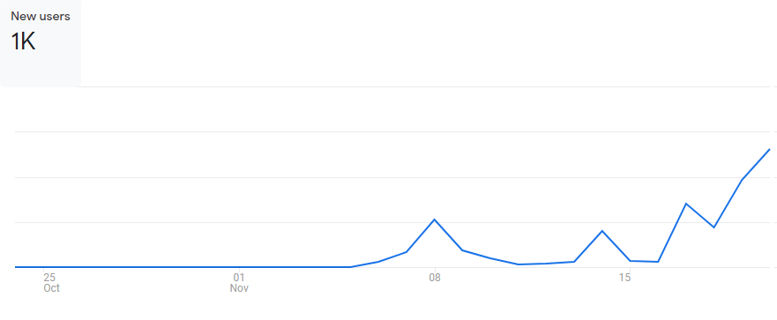
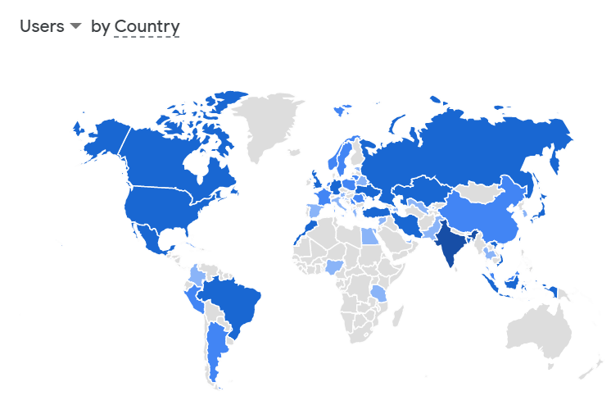
REACH AND AUDIENCE
We have 1k+ users registered and a daily active user strength of 100+ users.
Most users are from INDIA and USA.
We are expecting to reach 3k+ users by the end of the year.

Slide 8
FURTHER STEPS
We are heading to add much more features which already are being implemented. These include:
Roadmap to Competitive Programming: We are making a game for competitive programming lovers which will be a series of blogs and contest in a very very competitive mode.
Contest Analysis: We are looking forward to add Contest Analysis after each contest through which user can more efficiently look their mistakes.

Slide 9
ACKNOWLEDGEMENT
We would like to thank DTU for giving us an opportunity to showcase our work, codeforces for providing us with APIs and a great platform for CP lovers, NodeJs, SocketIO, and FireBase (open source softwares we used).
https://codeforces.com/
https://nodejs.org/en/
https://socket.io/
https://firebase.google.com/

Slide 10
Thank you !

